Slide 1
Negative Control Causality Measure
by Zongyu Li

Slide 2
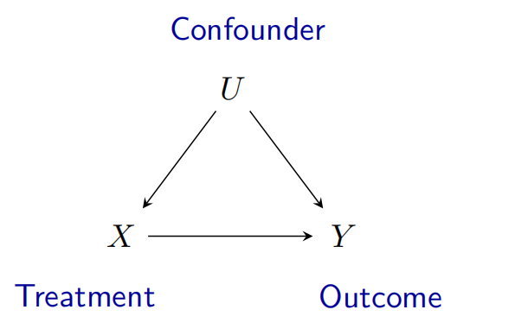

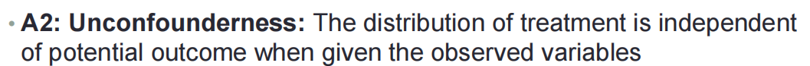
Assumption Unconfounderness

Slide 3
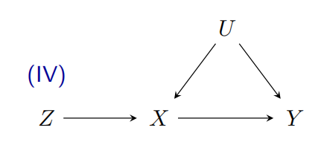


Assumption Exclusion

Slide 4
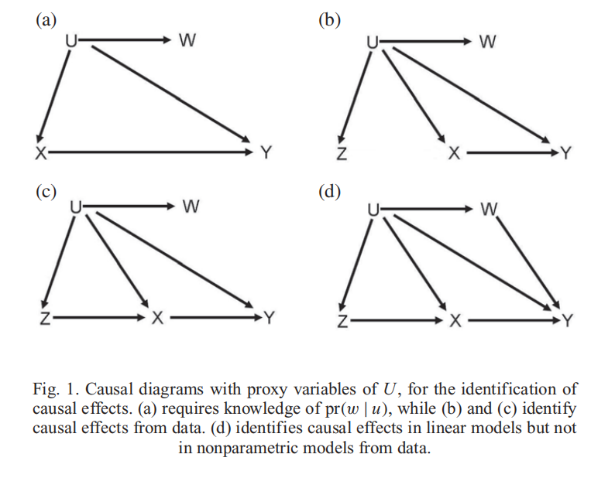
Proximal inference(Linear models)
Kuroki M, Pearl J. Measurement bias and effect restoration in causal inference[J]. Biometrika, 2014, 101(2): 423-437.

Slide 5
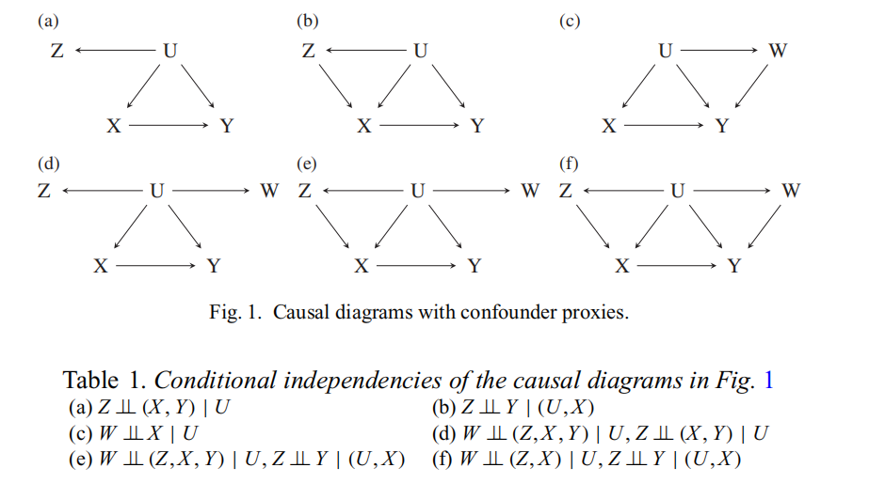
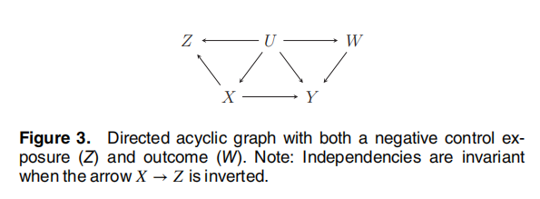
Negative controls/Proximal inference
Negative controls克服 p(w/u) ！！！
Miao W, Tchetgen Tchetgen E. Invited commentary: bias attenuation and identification of causal effects with multiple negative controls[J]. American journal of epidemiology, 2017, 185(10): 950-953.
Miao W, Geng Z, Tchetgen Tchetgen E J. Identifying causal effects with proxy variables of an unmeasured confounder[J]. Biometrika, 2018, 105(4): 987-993.

Slide 6
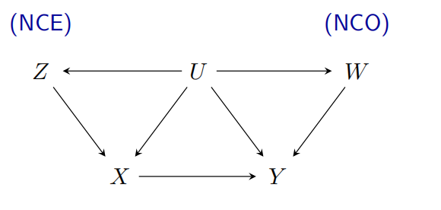
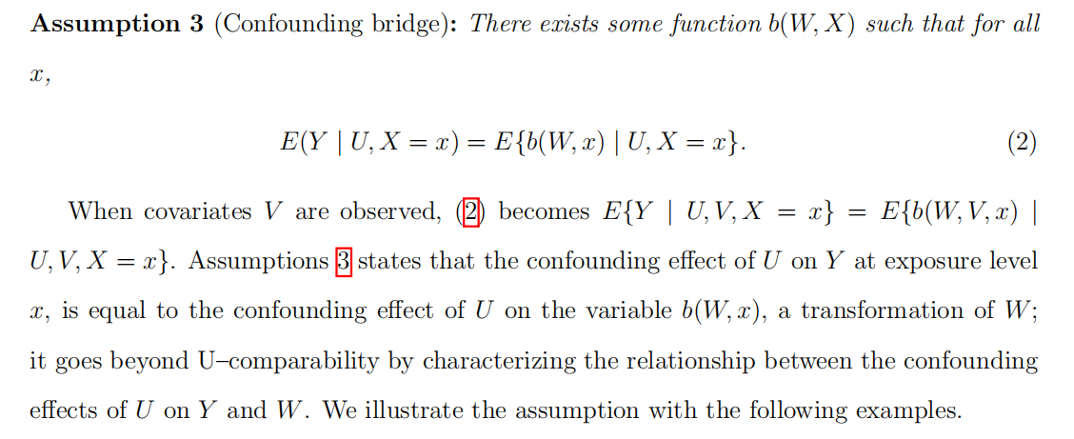
Confounding bridge function(NCO)
Miao W, Shi X, Tchetgen E T. A confounding bridge approach for double negative control inference on causal effects[J]. arXiv preprint arXiv:1808.04945, 2018.

Slide 7
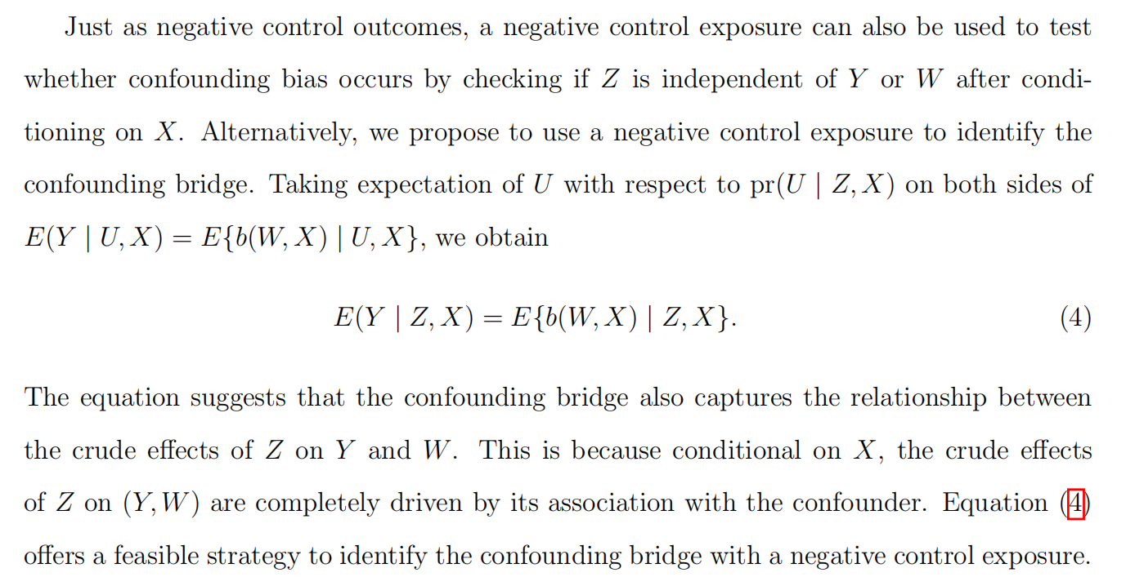



Confounding bridge function(NCE)
Resolved exclusion assumption !!!
Miao W, Shi X, Tchetgen E T. A confounding bridge approach for double negative control inference on causal effects[J]. arXiv preprint arXiv:1808.04945, 2018.

Slide 8
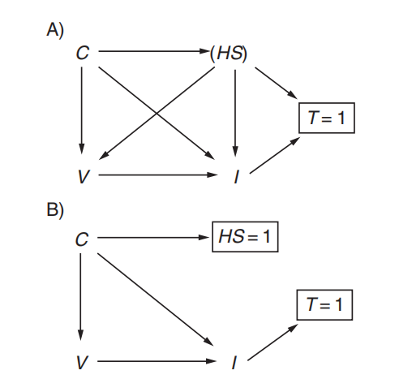
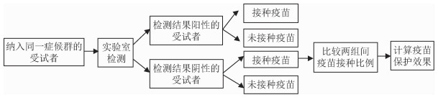
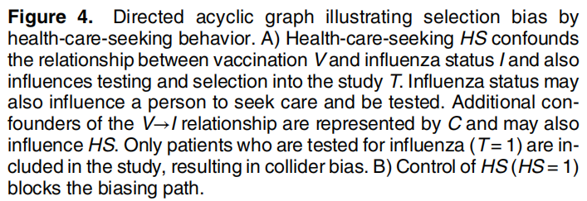
Test Negative Design Vaccine Effectiveness
Sullivan S G, Tchetgen Tchetgen E J, Cowling B J. Theoretical basis of the test-negative study design for assessment of influenza vaccine effectiveness[J]. American journal of epidemiology, 2016, 184(5): 345-353.

Slide 9
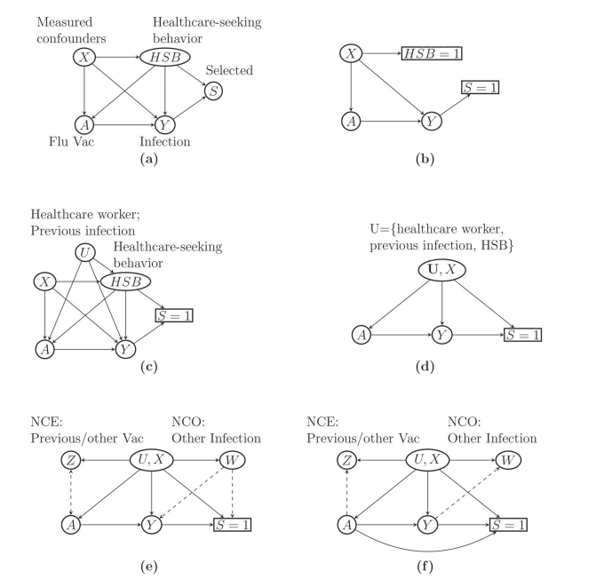
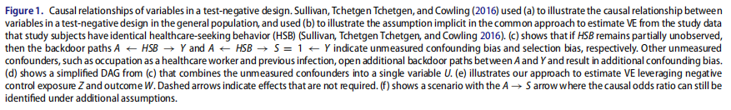
Double Negative Control TND Vaccine Effectiveness
Li K Q, Shi X, Miao W, et al. Double negative control inference in test-negative design studies of vaccine effectiveness[J]. Journal of the American Statistical Association, 2023: 1-12.

Slide 10

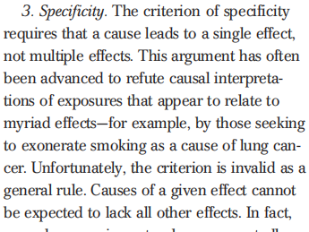
BackGround of Specificity
Doll R, Hill A B. Smoking and carcinoma of the lung[J]. British medical journal, 1950, 2(4682): 739.
Rothman K J, Greenland S. Causation and causal inference in epidemiology[J]. American journal of public health, 2005, 95(S1): S144-S150.

Slide 11

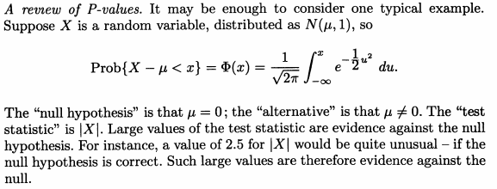
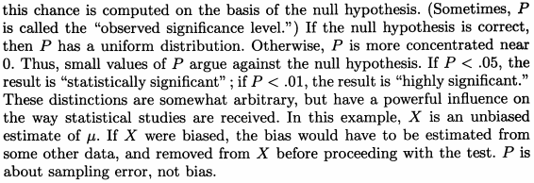
P-values
Freedman D. From association to causation: some remarks on the history of statistics[J]. Journal de la société française de statistique, 1999, 140(3): 5-32.

Slide 12
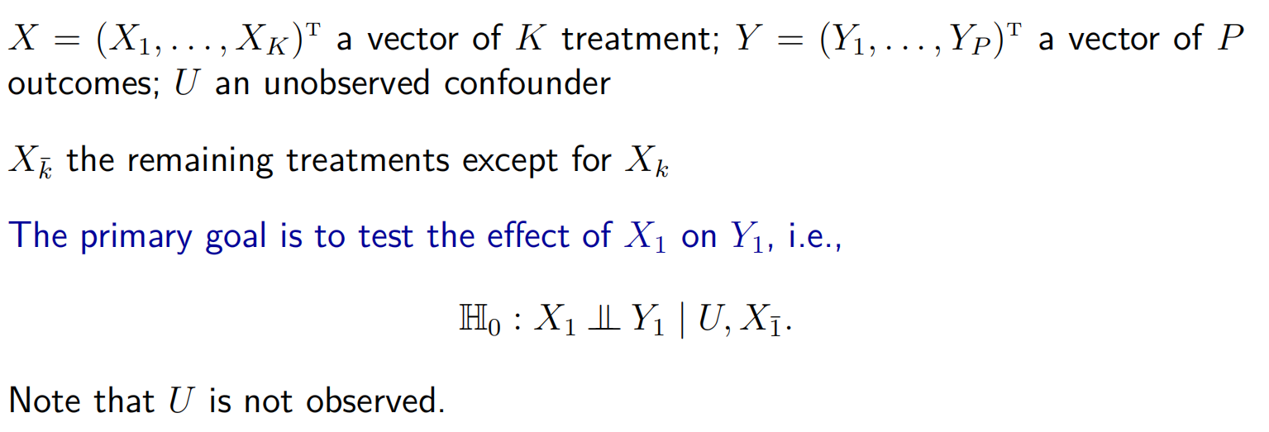
Notation and setting

Slide 13
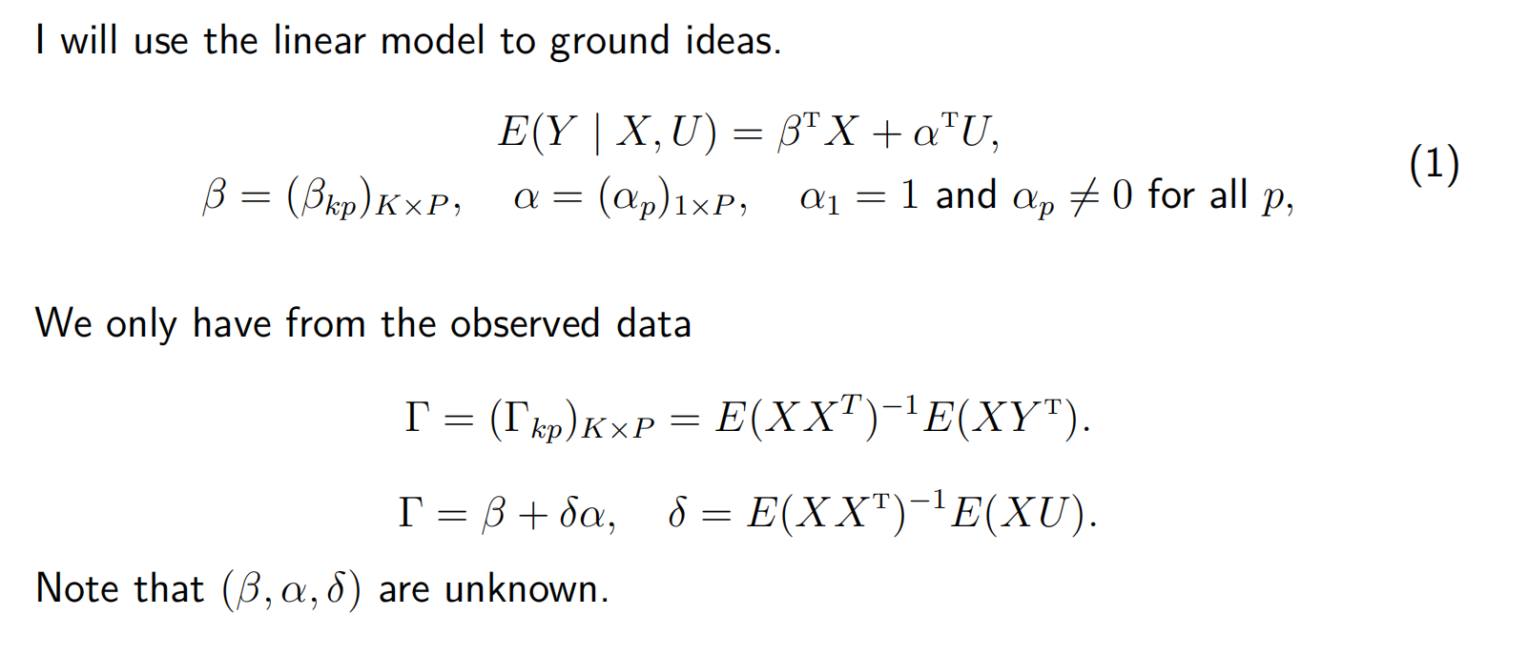
Notation and setting

Slide 14
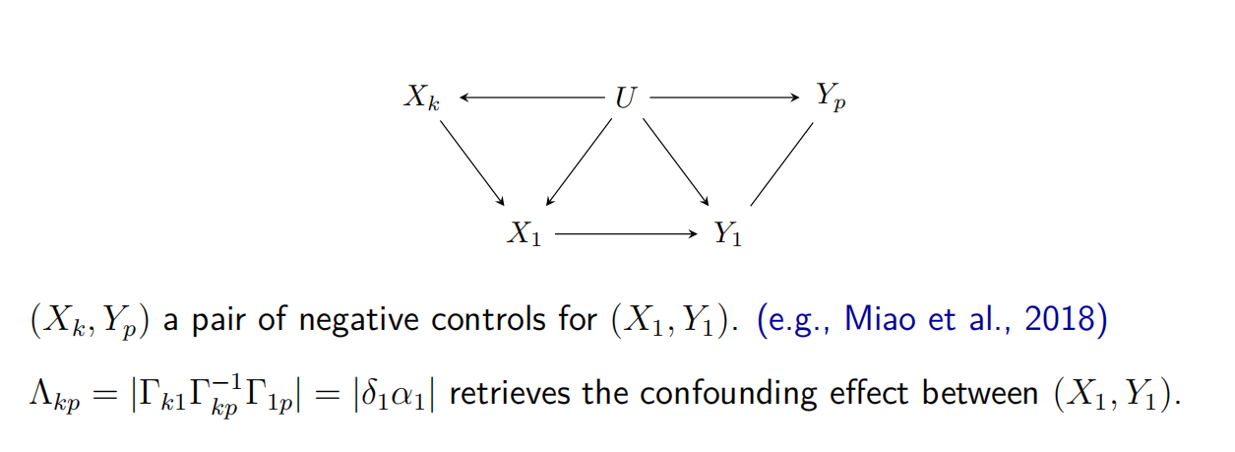




Specificity

Slide 15
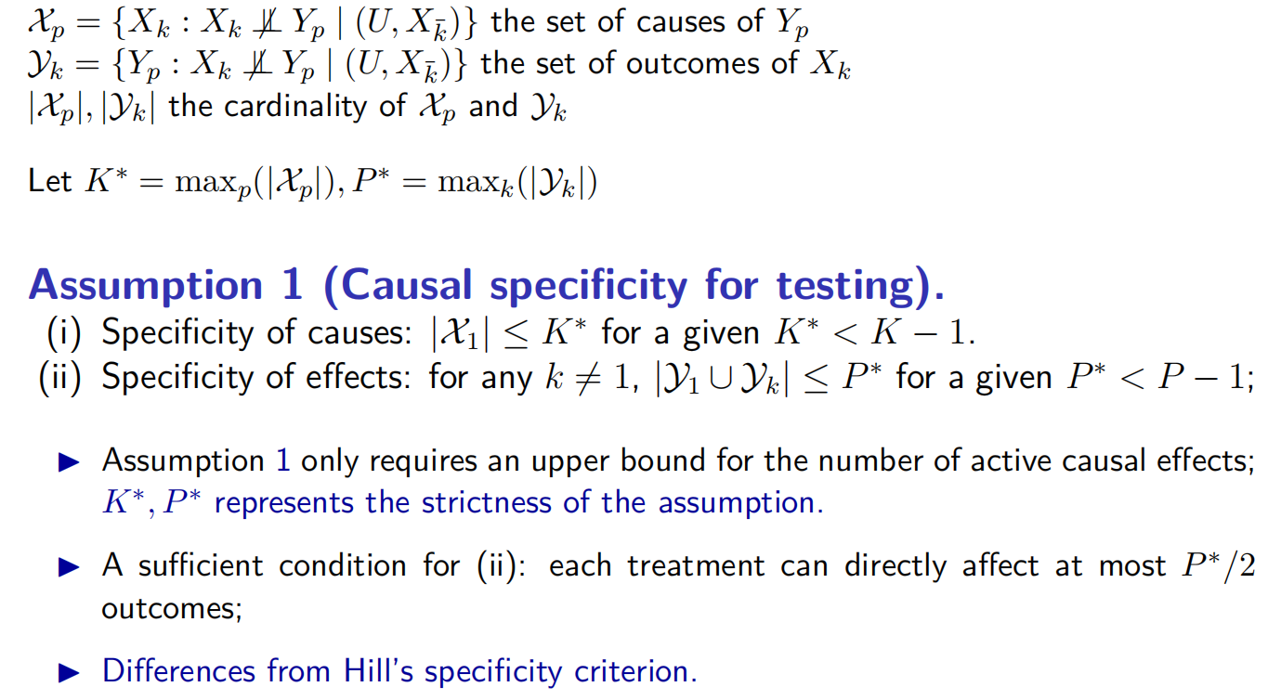
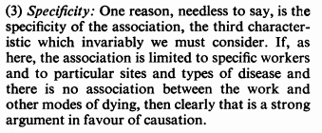


Causal specificity assumption
Hill A B. The environment and disease: association or causation?[J]. 1965.

Slide 16
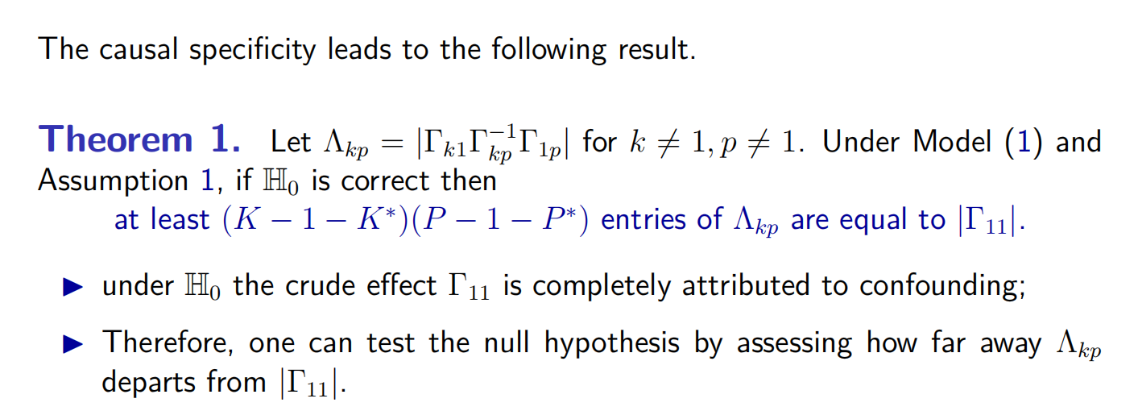



Implications of causal specificity
Freedman D. From association to causation: some remarks on the history of statistics[J]. Journal de la société française de statistique, 1999, 140(3): 5-32.

Slide 17
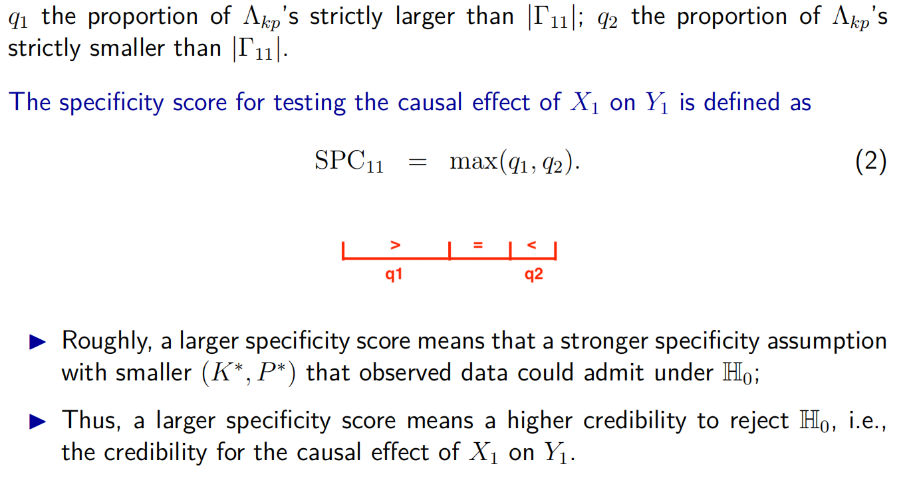
The specificity score

Slide 18
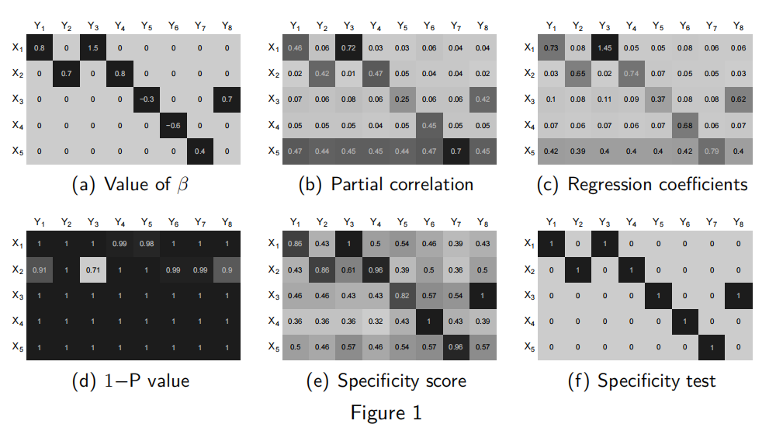
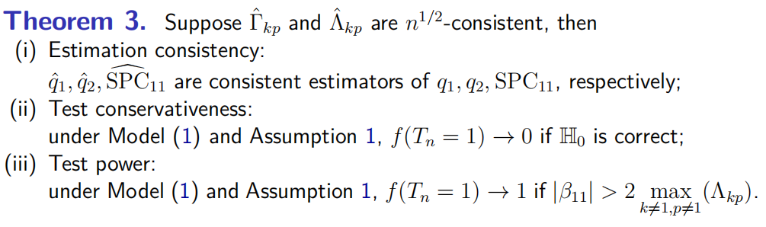

Specificity map

Slide 19
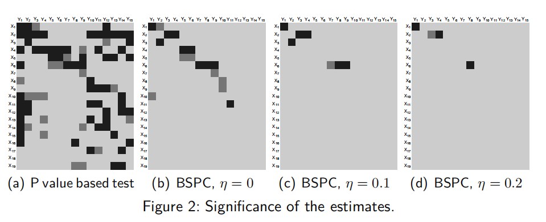

Application
Statics Process Control

Slide 20




Thinking
1.更好的应用场景？
2.是否可以用其他方法作为因果效应的评估代替specificity score，优化相关假设，如机器学习算法？统计相关知识还需加强！
3.类似Negative control的方法，解决confounder假设？
4.假设循环？discovery结构，不同结构用不同假设？

